Slide 1
JS CALENDAR
Raúl Cátedra Martínez
Estefanía Cordeiro Brión

Slide 2
Explain what lessons you’ve learned during this project
Teamwork (lean on your partners to solve problems)
Work with git and gitHub
Improve JavaScript knowledge
Save events to localStorage
Manipulate dates and their methods
Use setInterval to appear a warning on the screen every 10 seconds
Make animations

Slide 3
What problems have you encountered when developing this project?
Use git and Kanban
Manipulate dates and formats

Slide 4
Explain how you changed roles to develop the project for each phase
Divide the work doing tasks locally and in pair programming

Slide 5
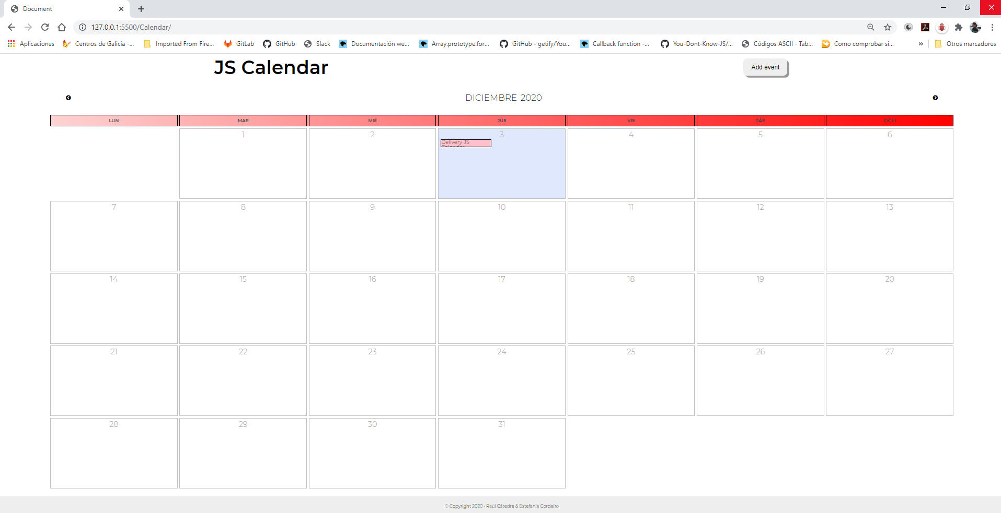
Google Chrome

Slide 6
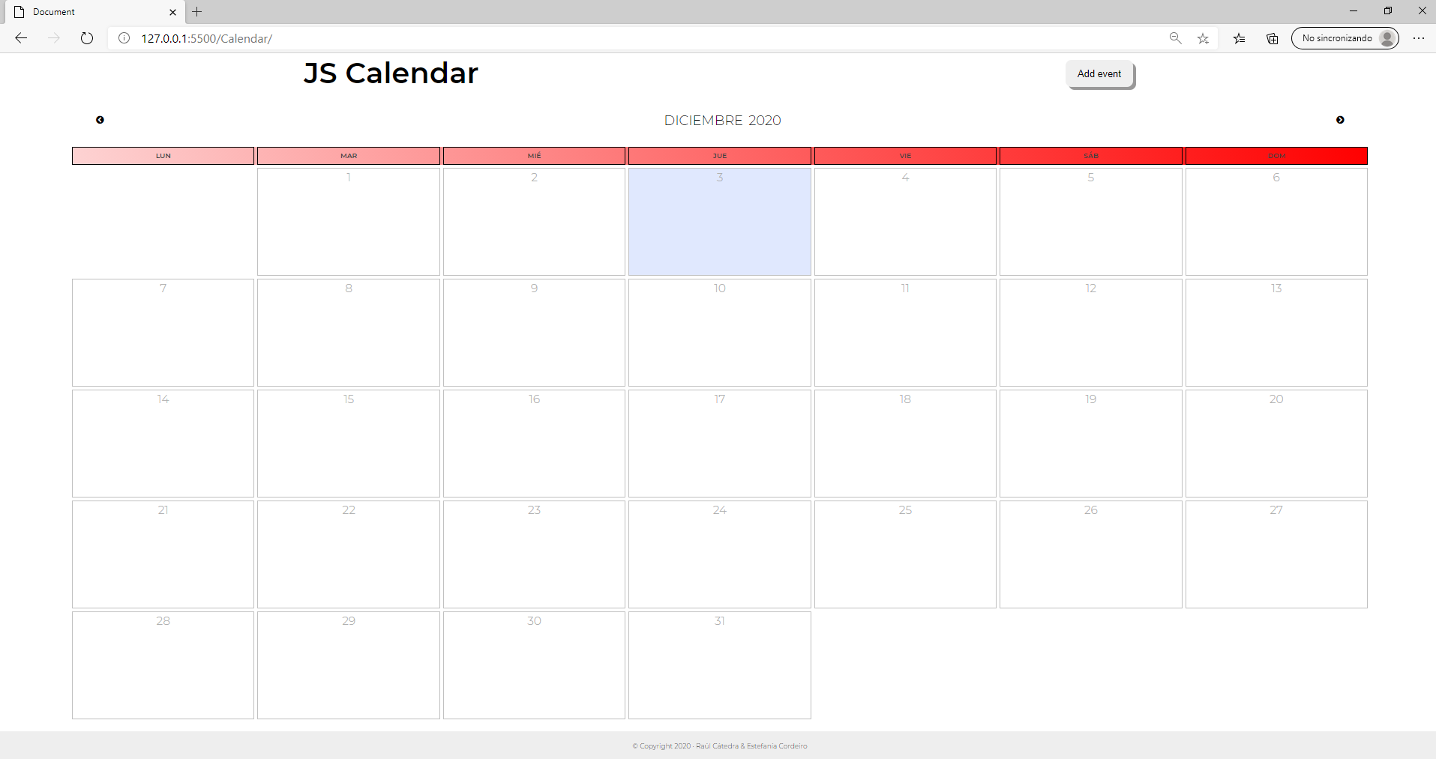
Microsoft Edge

Slide 7
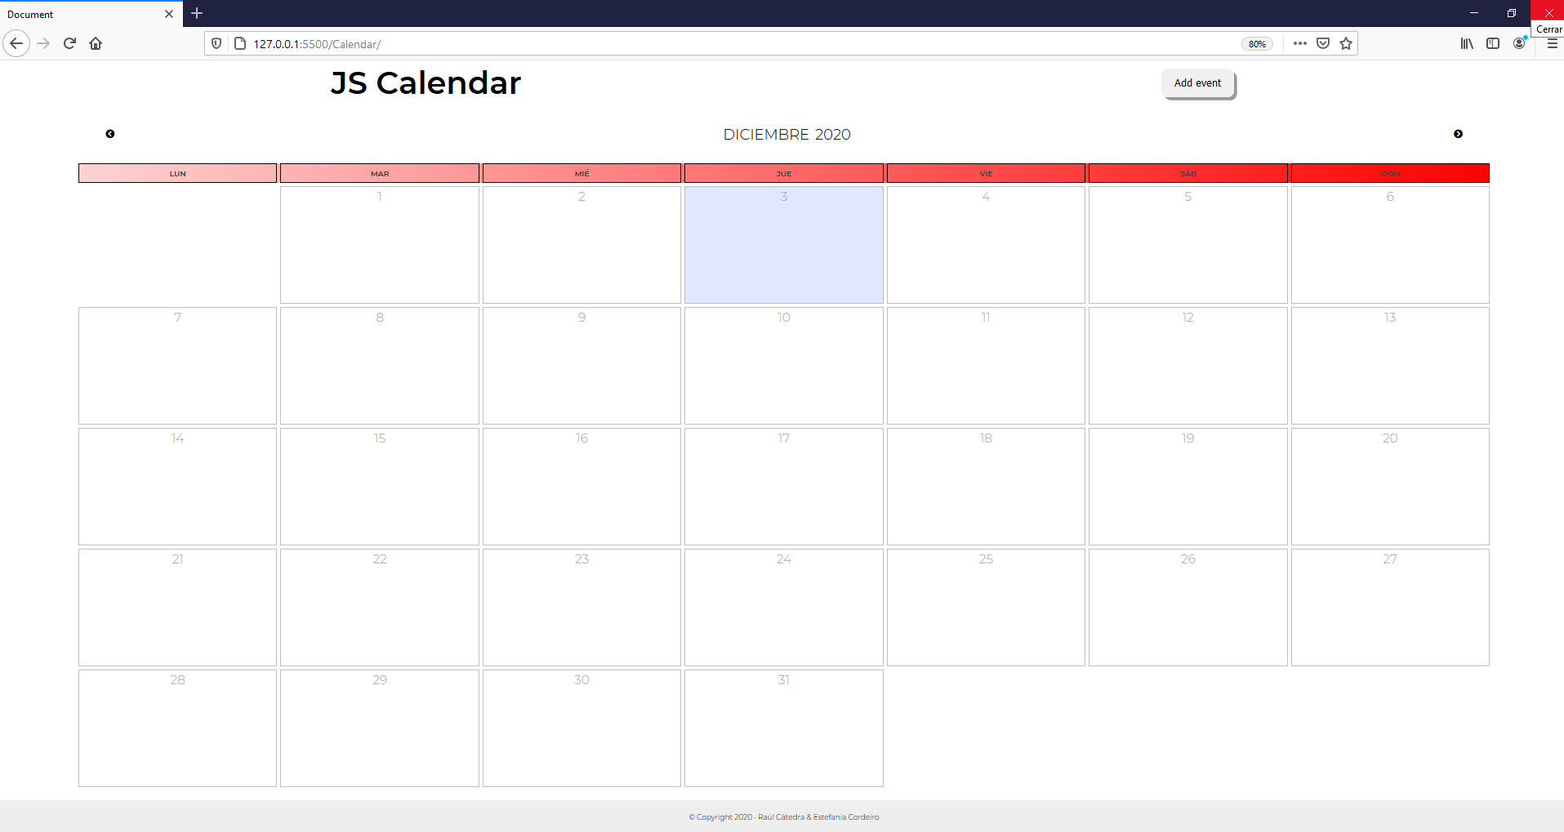
Mozilla Firefox

